Slide 1

Progress Report 5
Applied Language Team

Slide 2
Overview
Accomplishments
Challenges
Failures
Highlights
Goals
Concerns
Notes:
Kobe

Slide 3
Accomplishments
What the team accomplished during this time period
Updated old web pages
Created new web pages
Implemented navigation between pages
Starting phase 2 (getting the website operational)
Notes:
Kobe: During this reporting period the team finished the bulk of creating new pages and updating existing pages for the website. We have tailored these pages to match the prototypes that we created last semester. We believe the new pages have a better format for usability and accessibility by users. The team also started working on some phase 2 implementation tasks such as getting familiar with Django (our web framework) and starting development of back-end changes to the website to create the functionality that the website needs to operate.

Slide 4
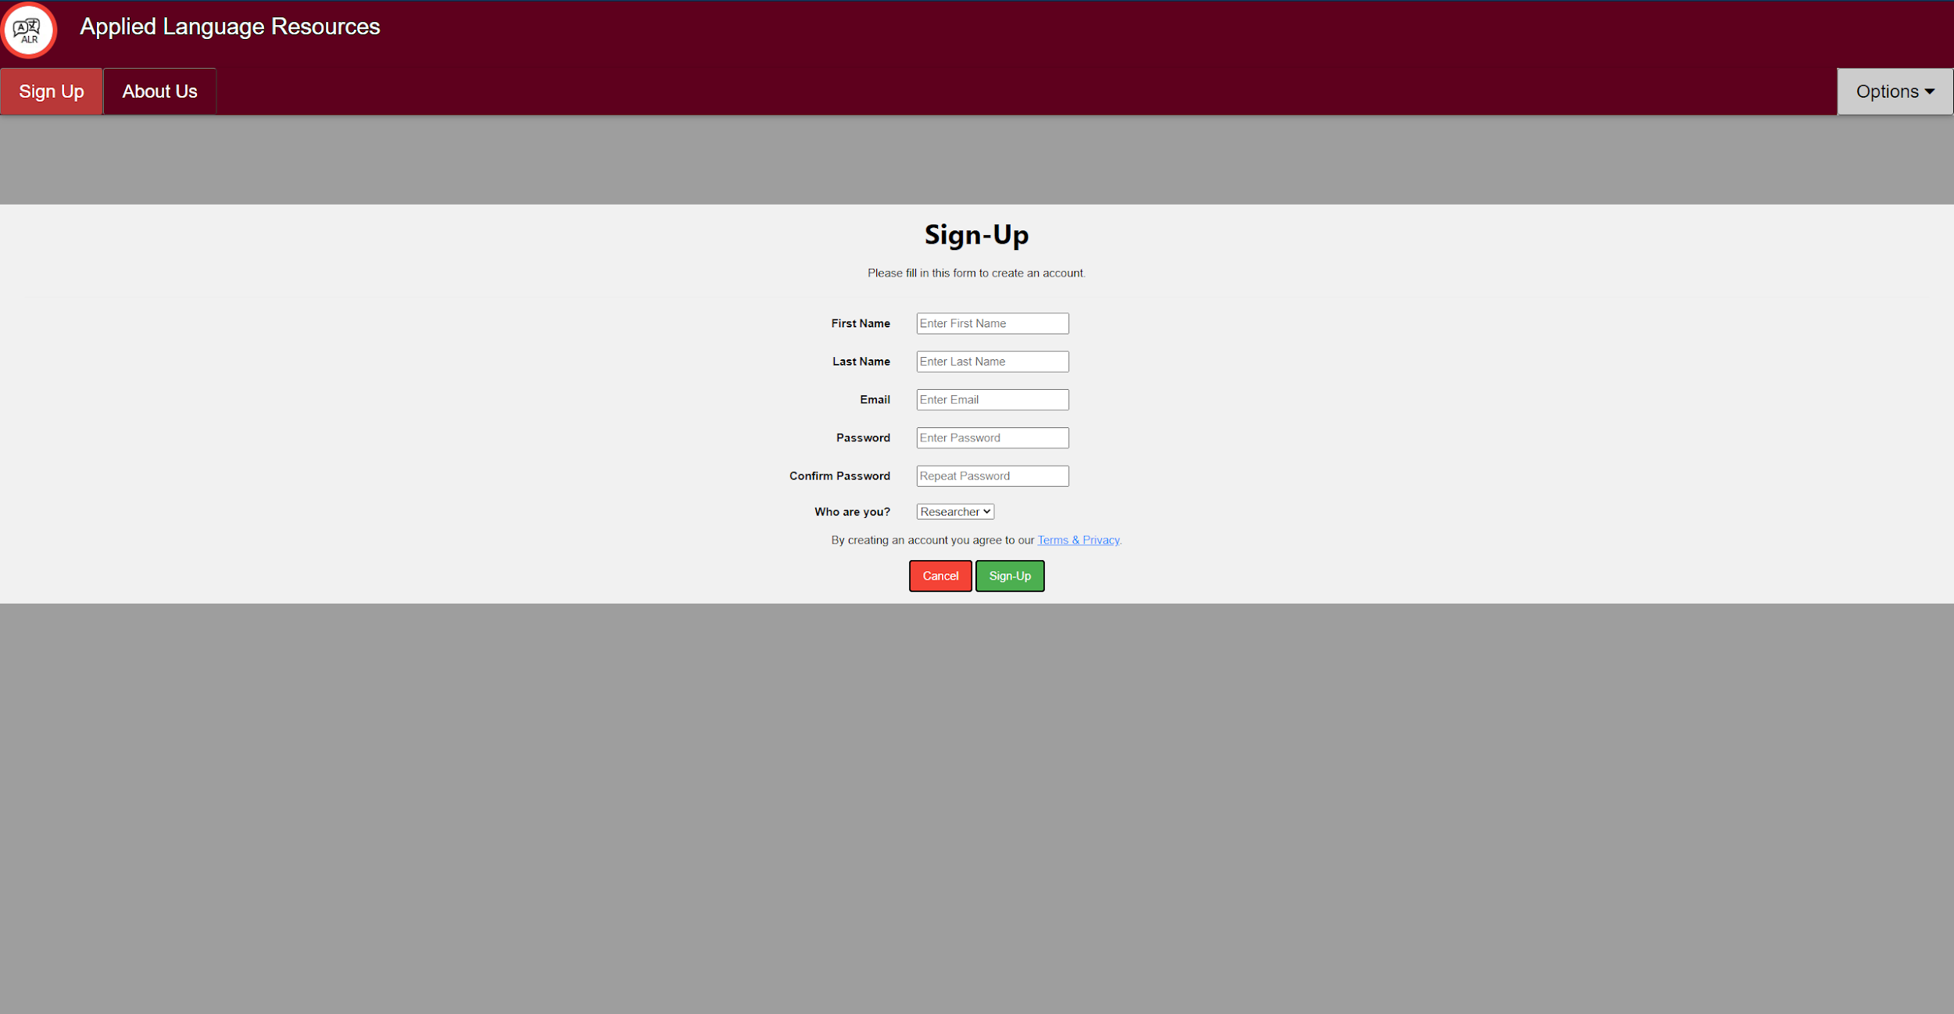
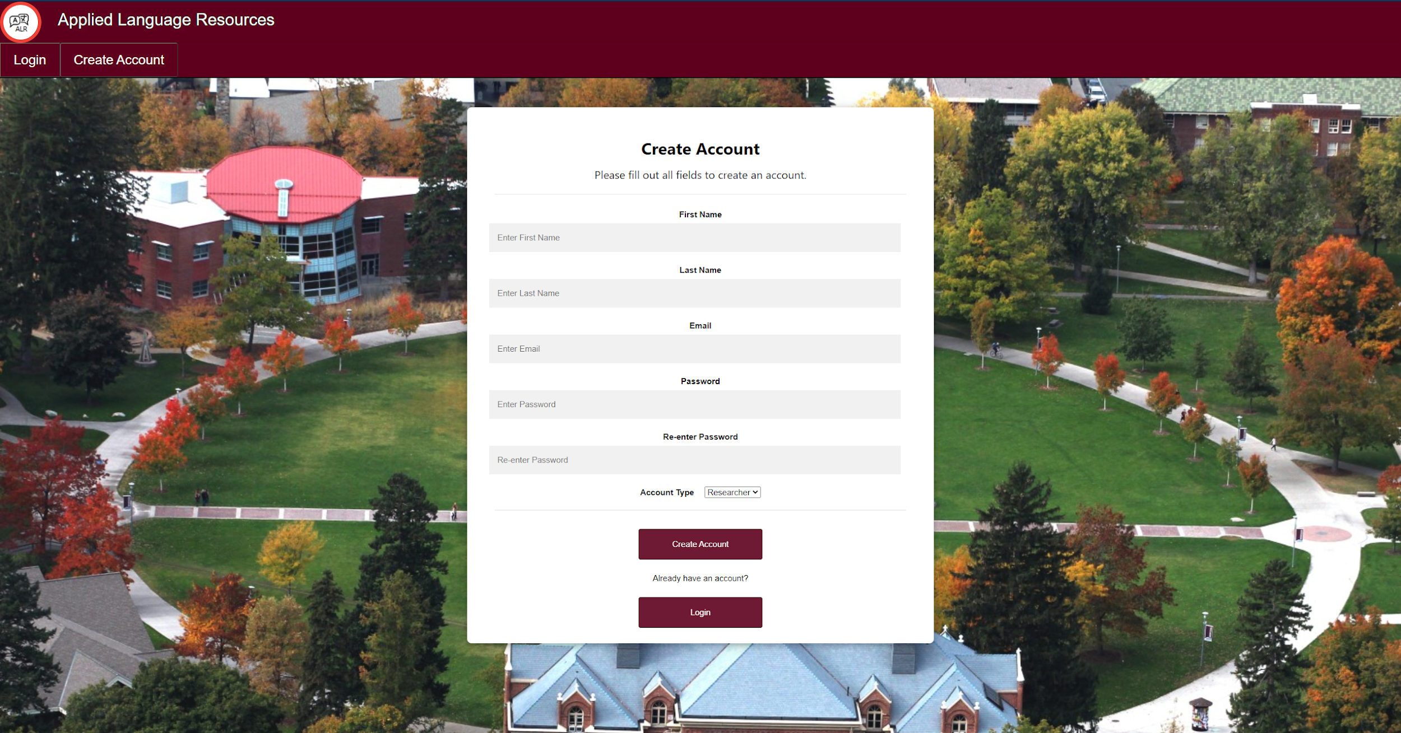
Registration
Old
New

Slide 5
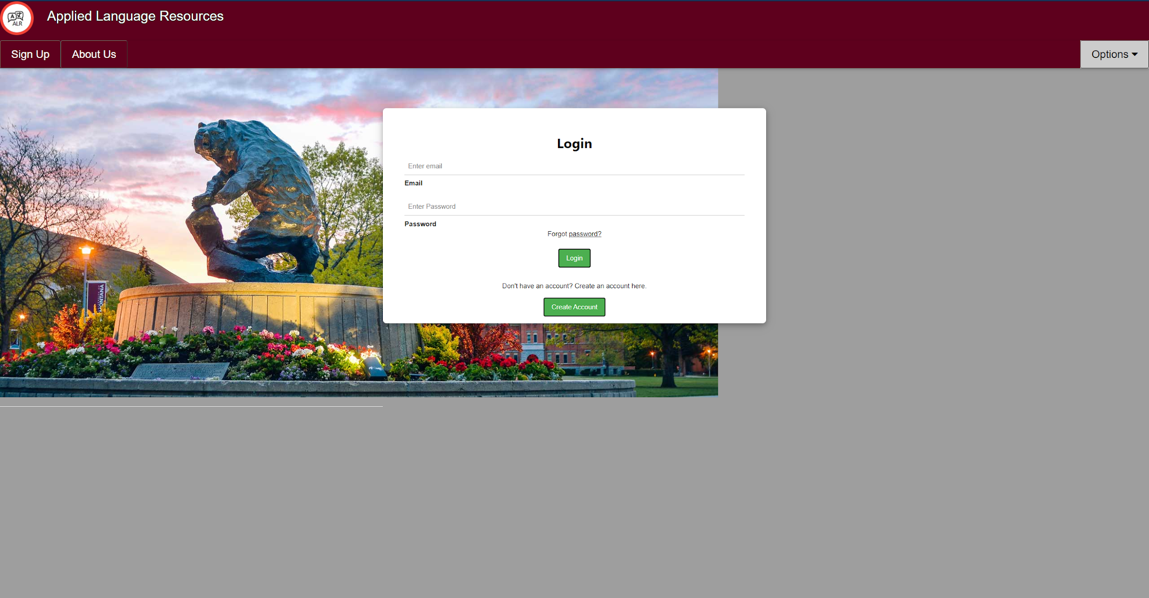
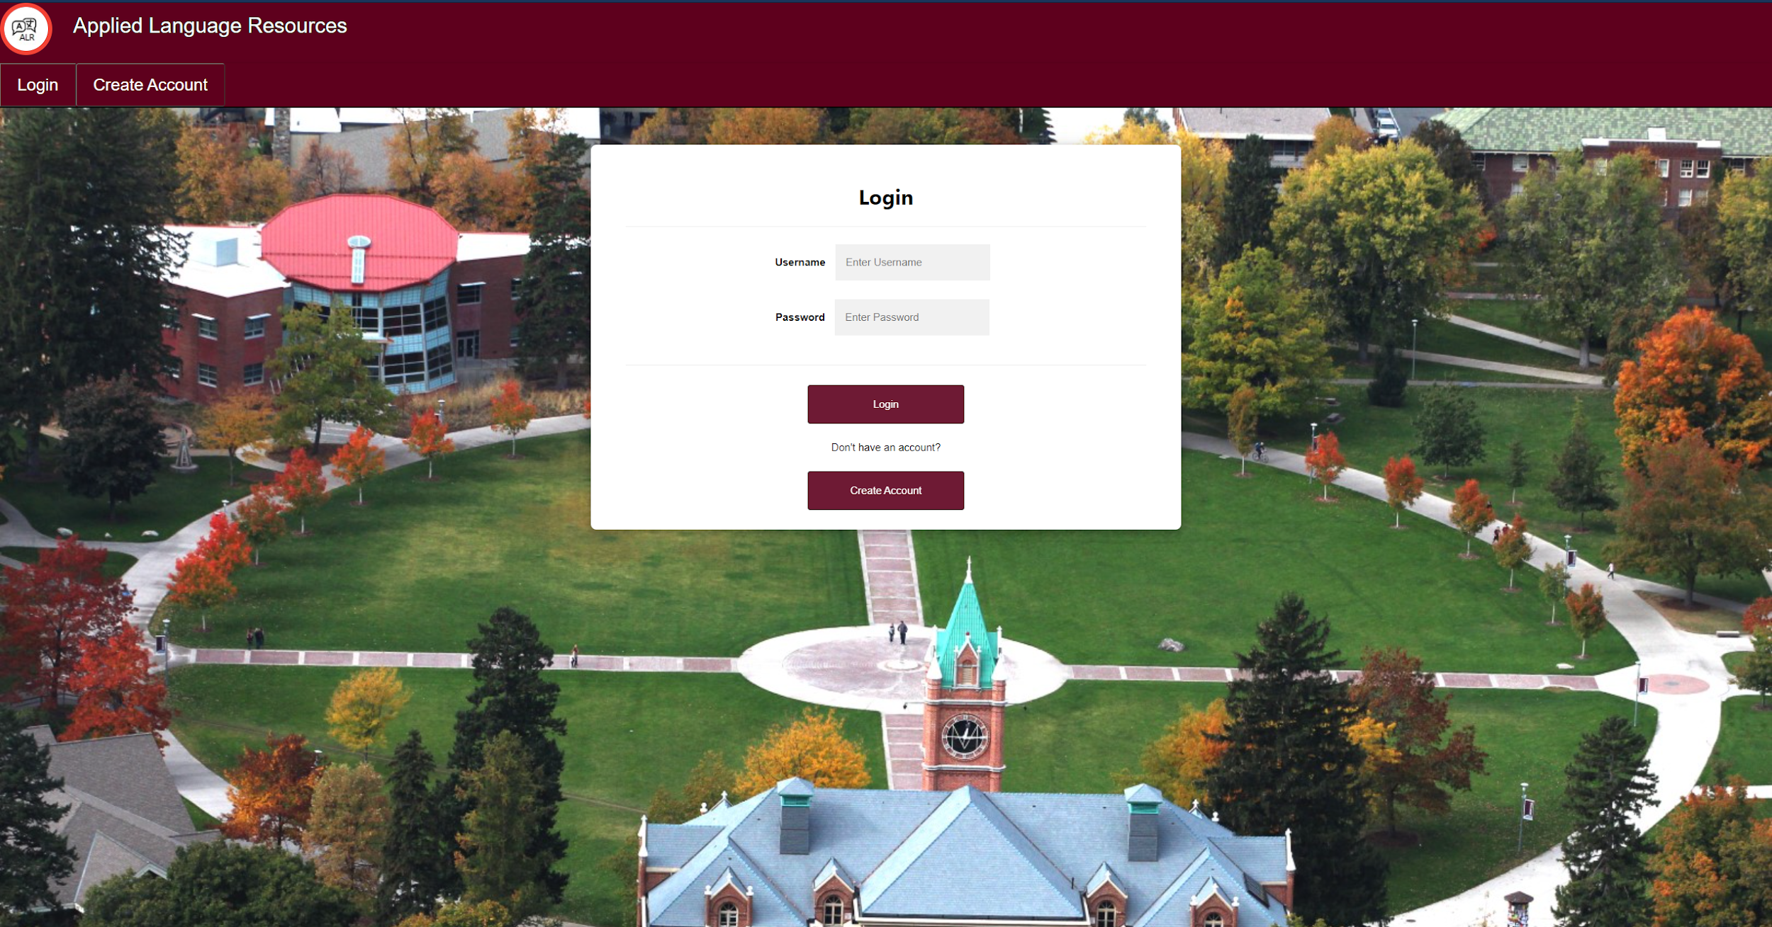
Login
Old
New

Slide 6
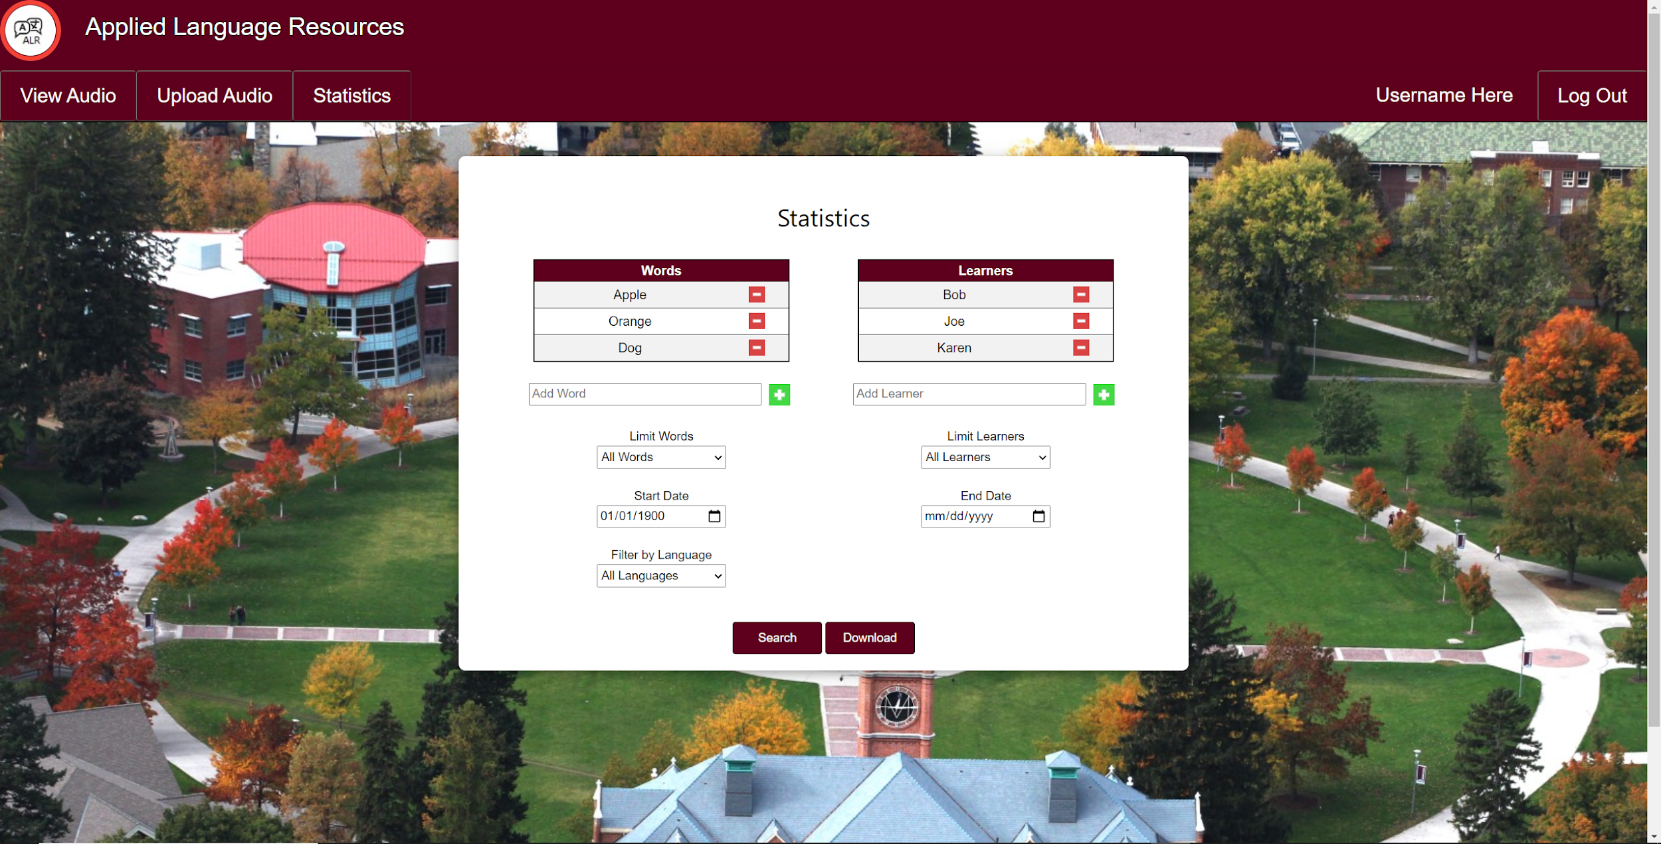
Statistics

Slide 7
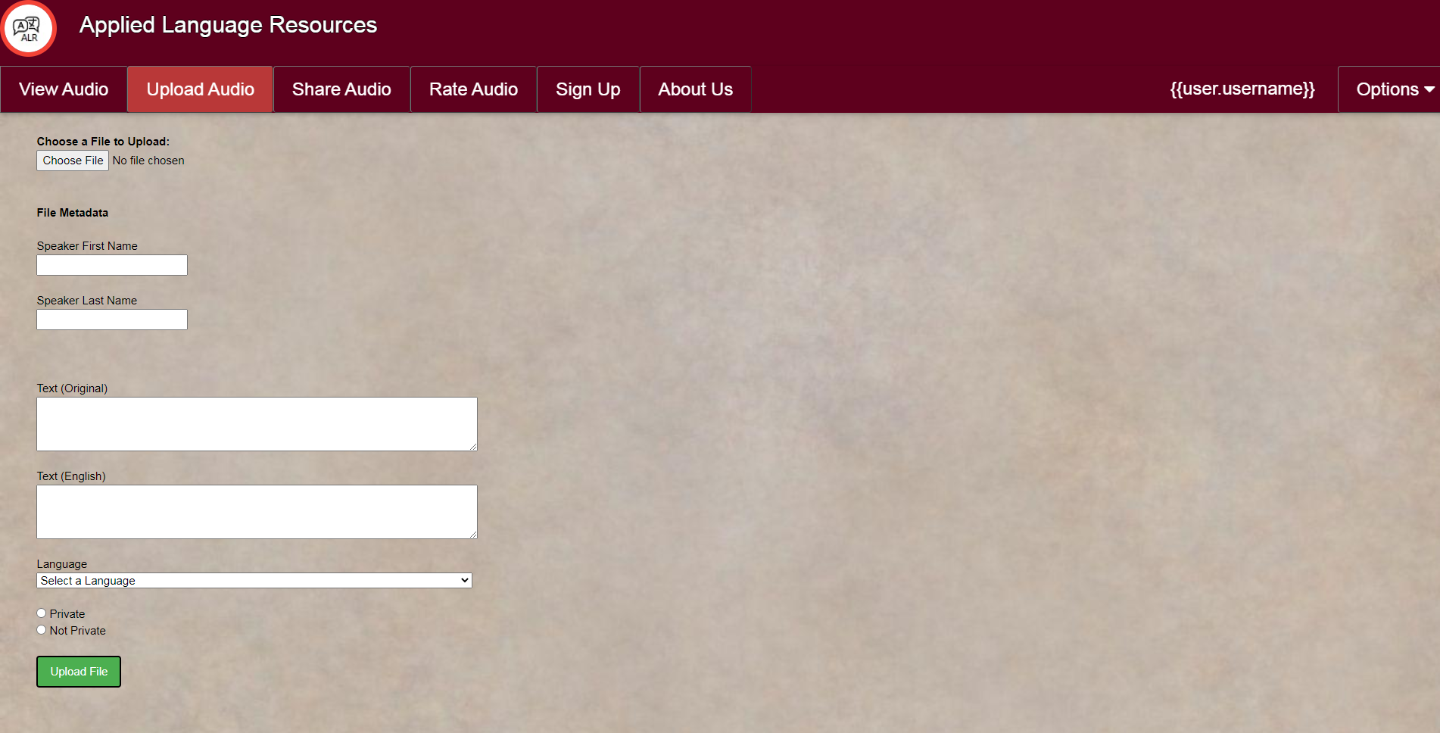
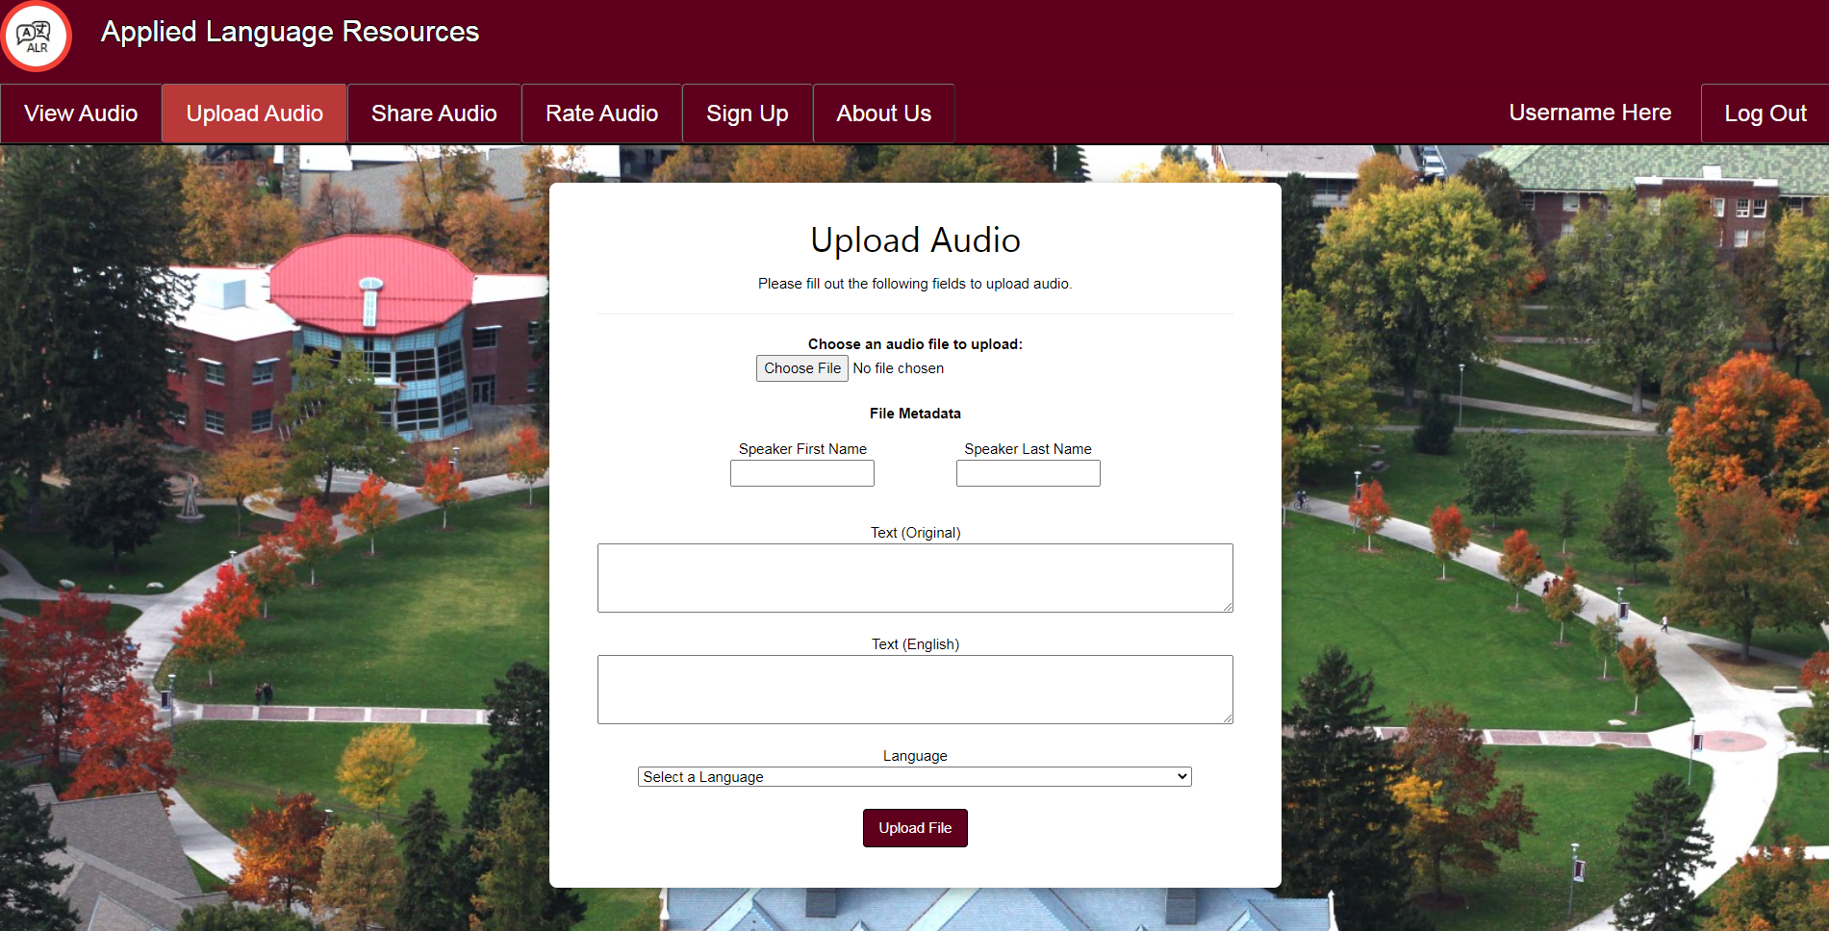
Upload Audio
Old
New

Slide 8
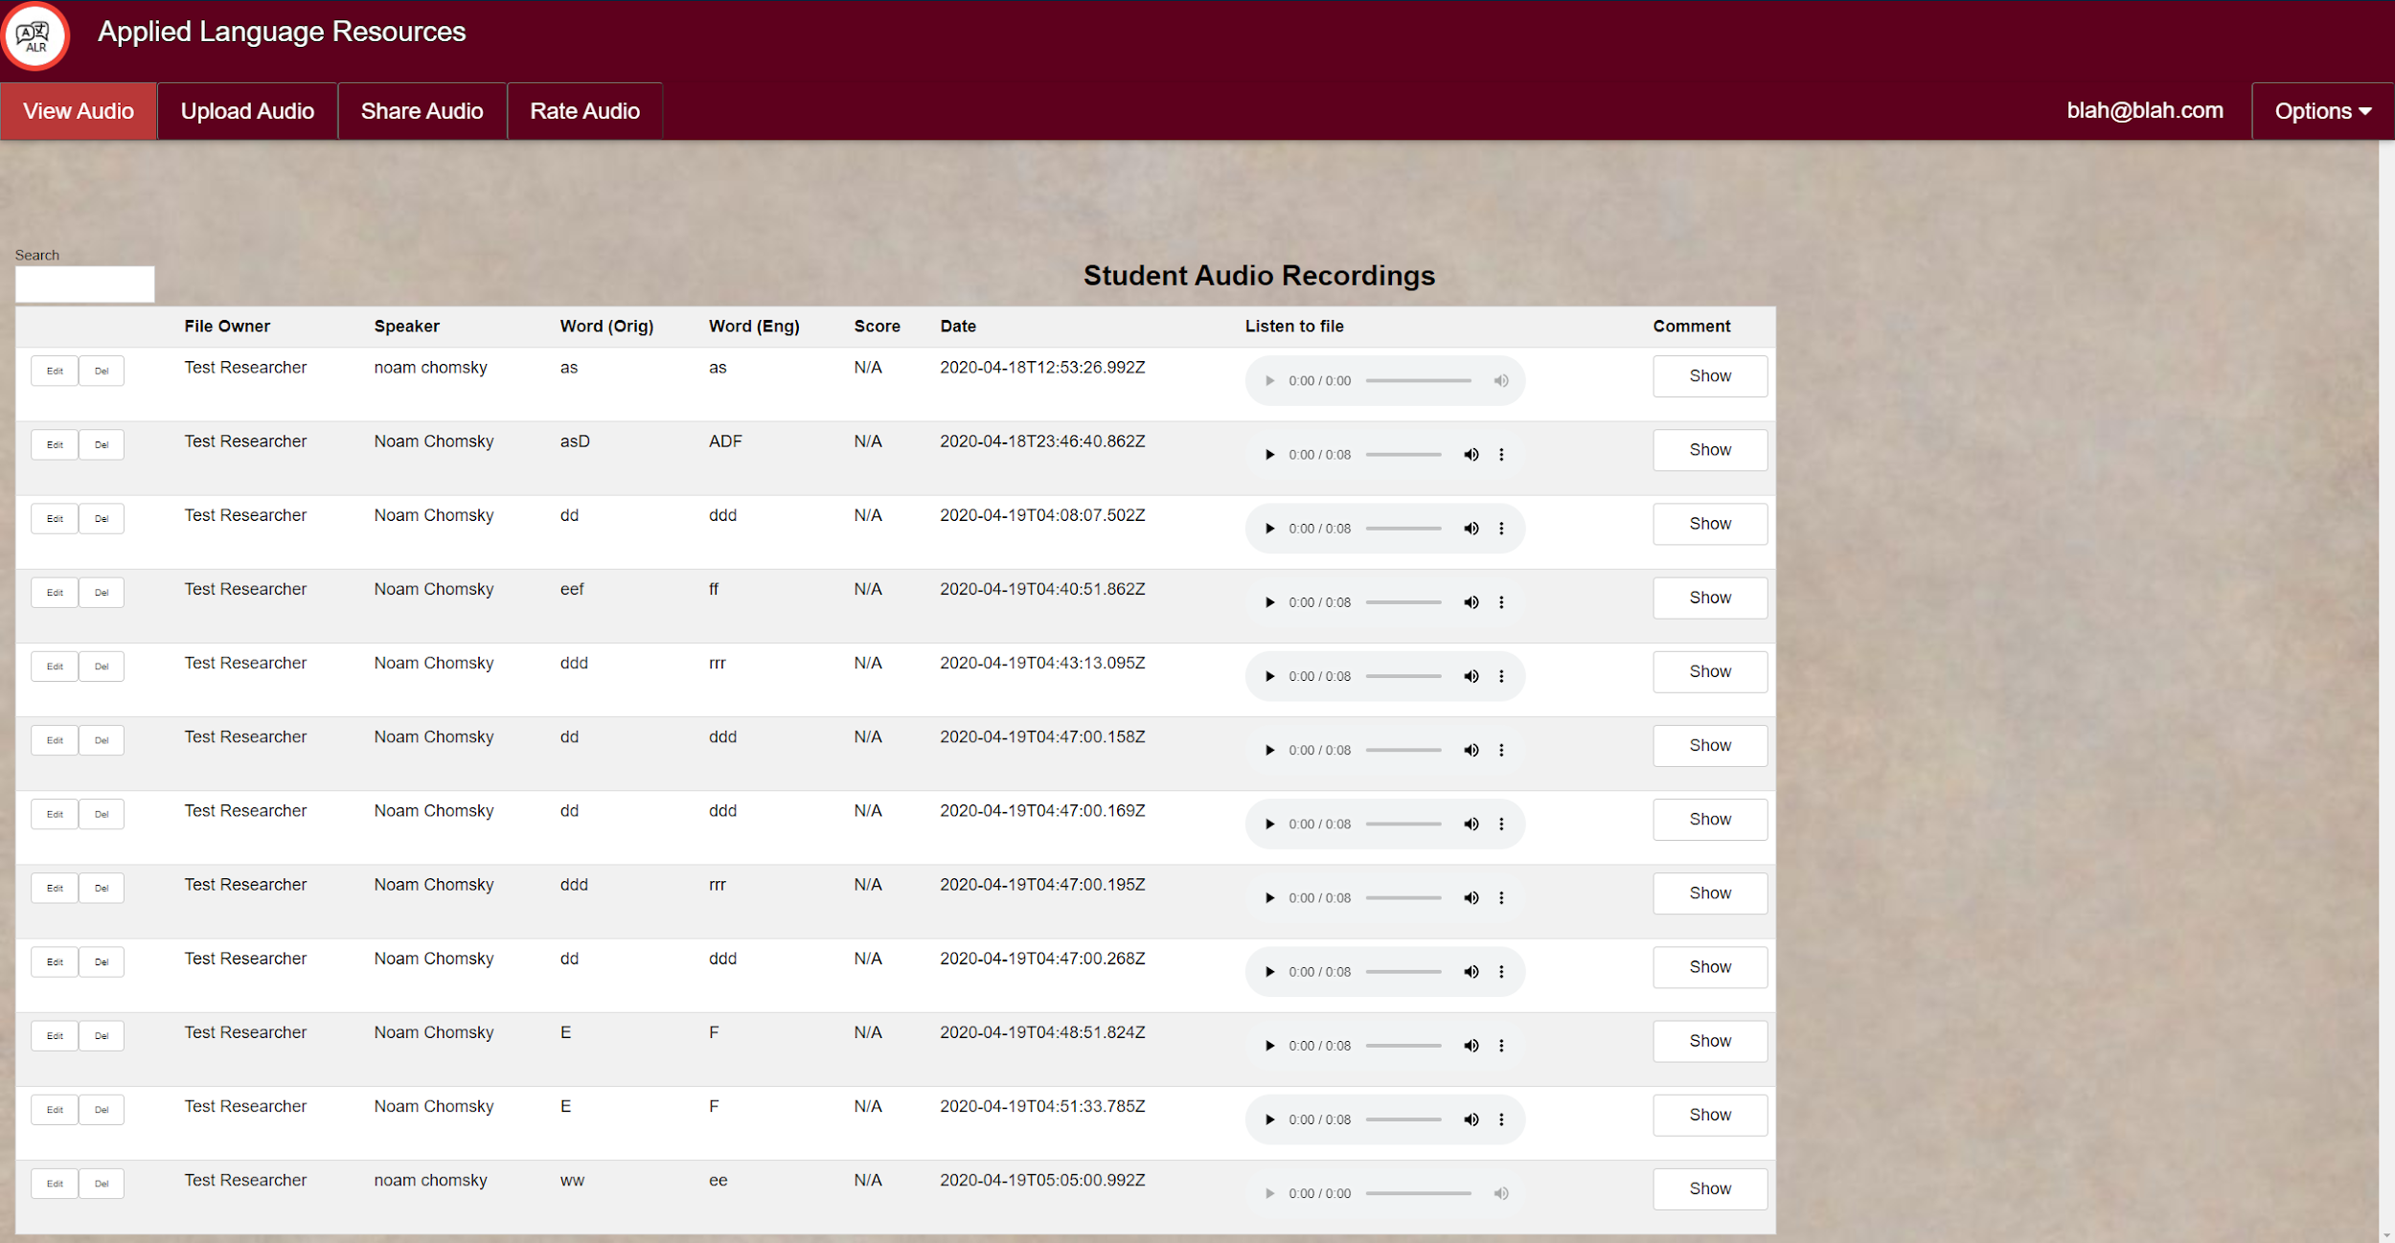
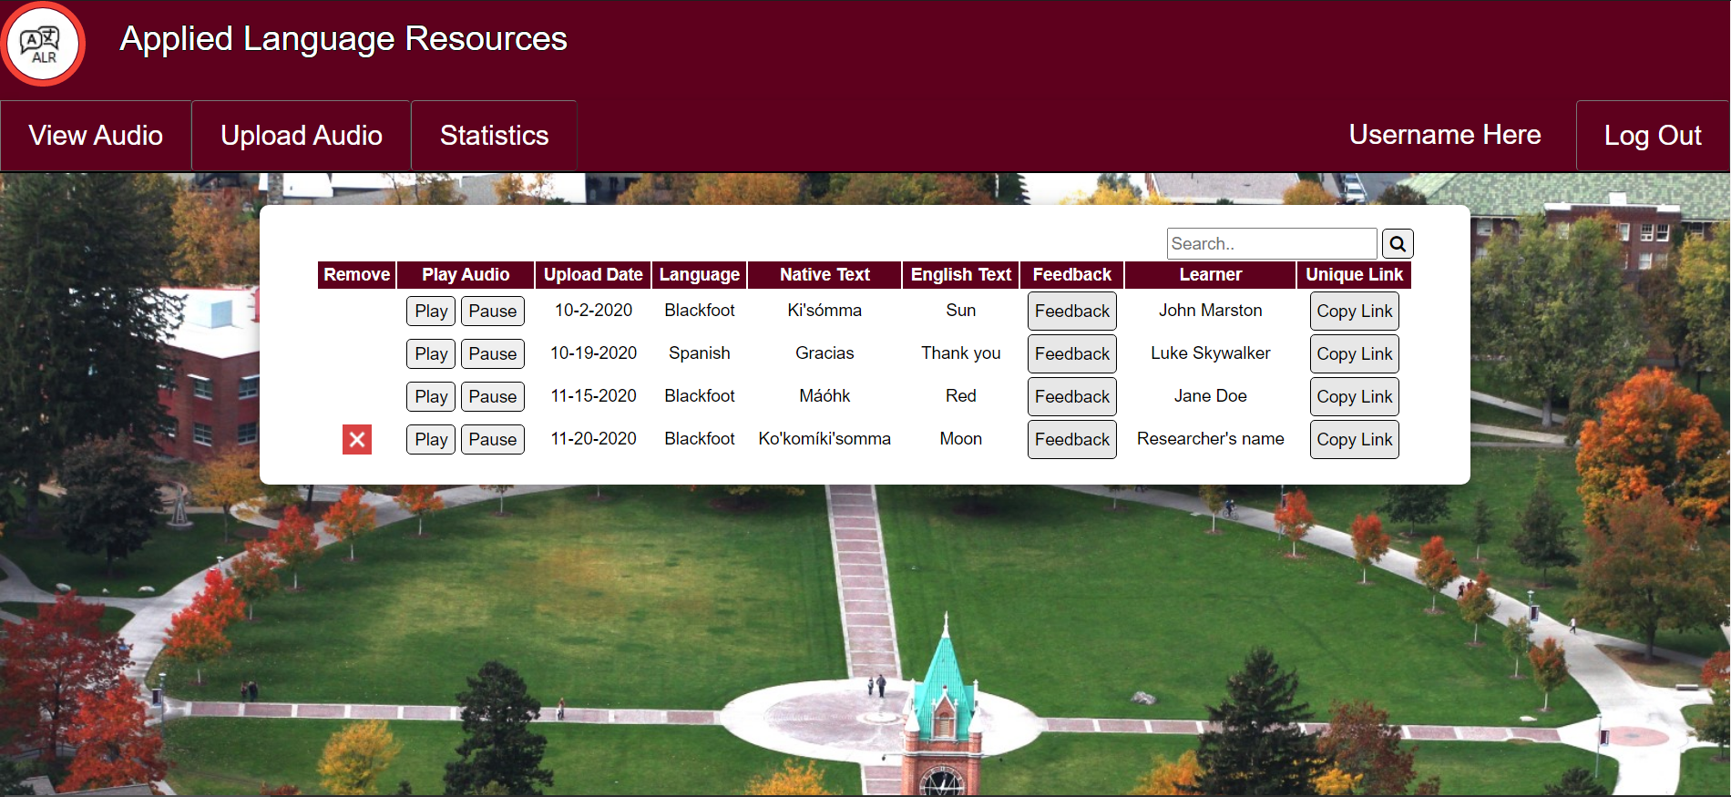
View Audio
Old
New

Slide 9
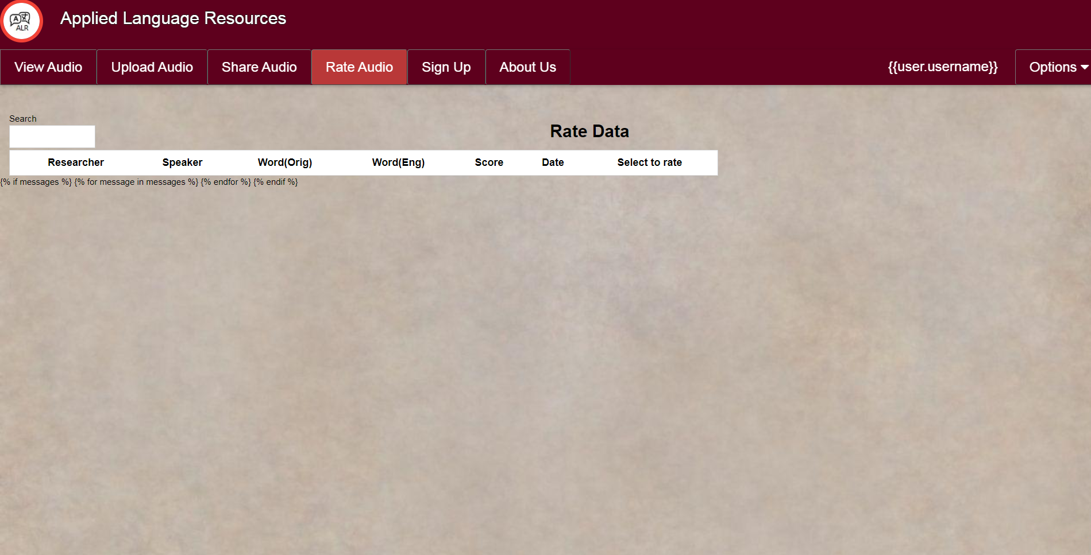
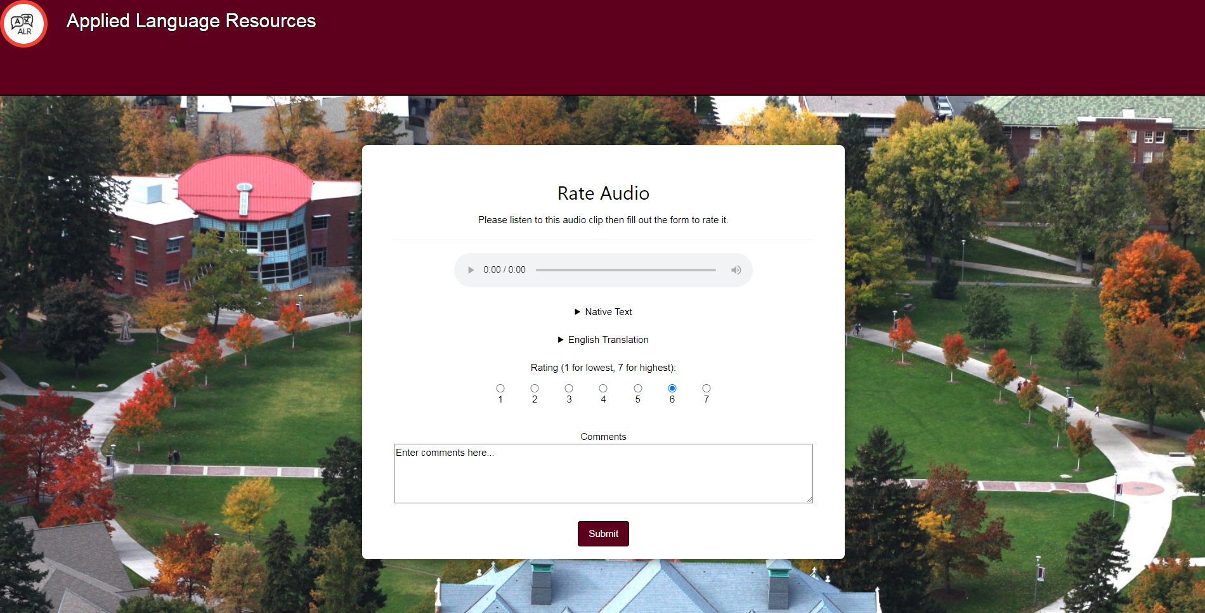
Rate Audio
Old
New

Slide 10
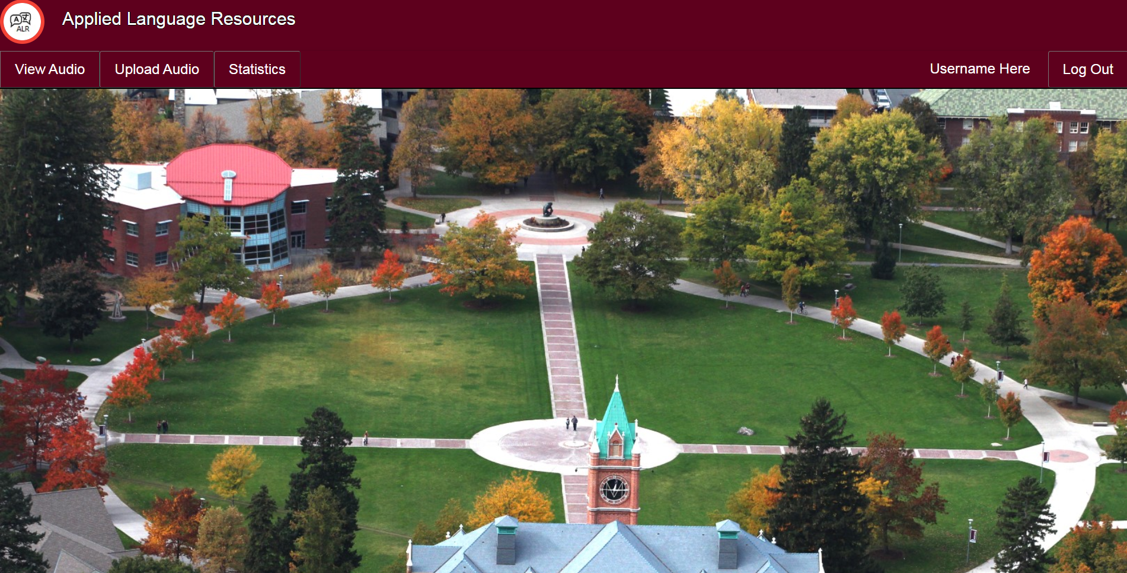
Home Page

Slide 11
Challenges
What particular challenges the team faced
Lack of Django / Web knowledge and experience
Learning prior team’s implementation choices
Notes:
David

Slide 12
Failures
What the team planned to accomplish but failed to
Week 1 Failure: Start coding in Django
Tutorials and experimentation
Week 2 progress
Notes:
David

Slide 13
Highlights
What accomplishments the team is most proud of
Good-looking web pages
Completion of tasks
Notes:
linda

Slide 14
Goals
What the team will accomplish during the next reporting period
Web page functionality
User registration and login
Uploading audio files
Rating audio
Notes:
linda

Slide 15
Concerns
Any other concerns the team would like to mention
Web service instability
Notes:
linda

Slide 16
Questions?
Notes:
All

